Slide 1
Computer Networks
By Shailesh Kumar Khanchandani

Slide 2
Topics Covered
Basic Communication Model.
Analog and Digital Signals.
Need and Advantages of Data Communications.
Network topologies and types of networks.
OSI reference model and TCP/IP Protocol Suite.
Layers in TCP/IP. Network Devices – Switch, Hub, Router, Gateway.
Circuit and Packet Switching.

Slide 3
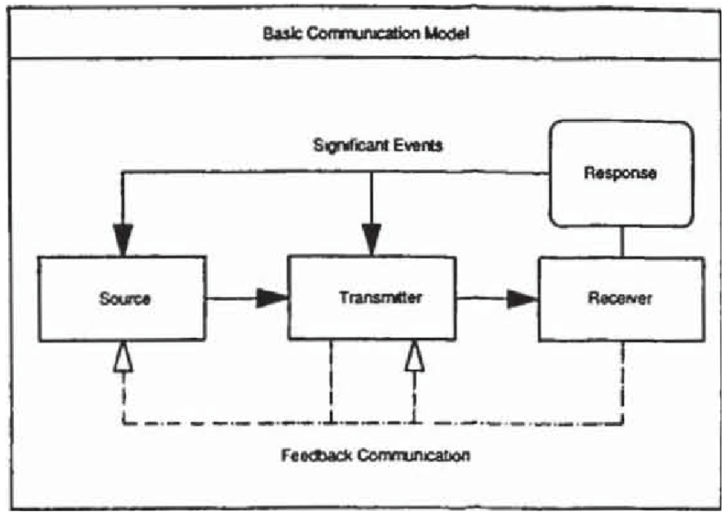
Basic Communication Model
The basic communication model is a simplified representation of the communication process. It outlines the key elements involved in transmitting a message from a sender to a receiver.

Slide 4
The core components of the basic communication model include:
Sender: The person who initiates the communication and transmits the message.
Message: The information that the sender wants to convey to the receiver. This can be verbal (spoken words) or non-verbal (body language, facial expressions, gestures).
Channel: The medium through which the message is transmitted. This can be face-to-face conversation, telephone, email, text message, social media, etc.
Receiver: The person who receives the message from the sender.
Feedback: The receiver's response to the message. This can be verbal or non-verbal and helps the sender gauge how well their message was understood.
Noise: Any interference that disrupts the communication process, such as background noise, distractions, or misinterpretations.
The basic communication model is a helpful tool for understanding the fundamental elements of communication. However, it is important to note that communication is a complex process and this model is a simplified representation. In the real world, communication is often more nuanced and can involve multiple senders and receivers, as well as multiple channels and messages being exchanged simultaneously.

Slide 5
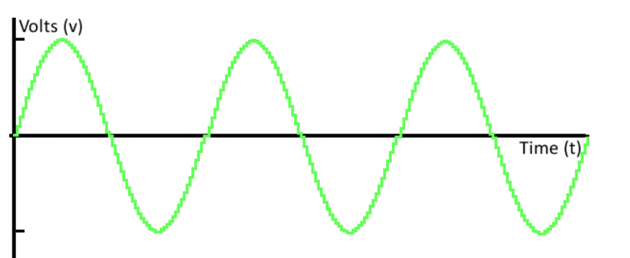
Analog and Digital Signals
In the context of communication, signals are electrical representations of information that can be transmitted between two or more points. These signals can be broadly categorized into two main types: analog and digital.
Analog signals are continuous signals that represent information by continuously changing their properties, such as voltage, amplitude, or frequency. These changes correspond to the variations in the information being carried.
Analogy can help understand this concept. Imagine a water tap. The flow of water from the tap can be continuously adjusted from a trickle to a full stream. The amount of water flowing at any given moment can represent the value of the analog signal.

Slide 6
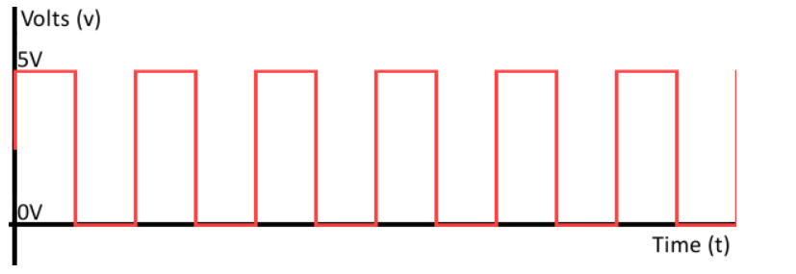
Digital signals, on the other hand, are discrete signals that represent information using a finite set of distinct values. These values are typically binary, meaning they can only be either 0 or 1. Digital signals often resemble a series of rectangular pulses, where the presence or absence of a pulse represents the binary digits.
Here's an analogy for digital signals: Imagine a light switch. The switch can only be in two states: on (representing 1) or off (representing 0).
The choice between using analog or digital signals depends on several factors, including the type of information being transmitted, the required transmission fidelity, and the limitations of the transmission channel.

Slide 7
Feature | Analog Signals | Digital Signals
Signal type | Continuous | Discrete
Values | Can take on any value within a range | Limited to a finite set of distinct values (often binary: 0 or 1)
Examples | Sound waves, temperature readings, voltage in an electrical circuit | Computer data, digital images, CD audio
Advantages | Simpler to generate and process in some cases, can represent a wider range of information | Less susceptible to noise and interference, easier to store and transmit
Disadvantages | More susceptible to noise and interference, can degrade over long distances | Requires more complex processing and transmission techniques

Slide 8
Need for Data Communication
Data communication is the transmission and reception of data (information) between two or more devices. In today's world, data communication is essential for various reasons, including:
Resource Sharing: Data communication allows users to share resources like printers, scanners, and storage devices across a network. This eliminates the need for each device to have its own resources, saving money and space.
Collaboration: Data communication enables collaboration between people in different locations. This is especially useful for businesses, where employees can work together on projects remotely.
Information Access: Data communication provides access to information from various sources, such as the internet, databases, and other computers. This allows people to stay informed and make better decisions.
Remote Operations: Data communication facilitates remote operations, such as remote monitoring and control of industrial processes, medical procedures, and transportation systems.

Slide 9
Advantages of Data Communication
Data communication offers several advantages over traditional communication methods, such as:
Speed: Data can be transmitted and received much faster than with traditional methods, such as postal mail or fax.
Efficiency: Data communication can save time and money by eliminating the need for physical transportation of data.
Accuracy: Data communication is less prone to errors than traditional methods, as errors can be detected and corrected during transmission.
Reliability: Data communication systems are typically more reliable than traditional methods, as they are often redundant and can recover from failures.
Scalability: Data communication systems can be easily scaled to accommodate a growing number of users or devices.
Security: Data communication systems can be secured with encryption and other security measures to protect sensitive information.

Slide 10
In conclusion, data communication is essential in today's world, as it enables resource sharing, collaboration, information access, remote operations, and offers several advantages over traditional communication methods.

Slide 11
Network topologies and types of networks
World of network topologies and network types.
Network Topologies: The Blueprint of Connections
A network topology refers to the layout of devices and connections within a network. It defines how devices are arranged and how data flows between them. There are two main categories of network topologies:
Physical Topology: This describes the physical layout of cables and devices in a network. It's like the blueprint for the wiring and equipment.
Logical Topology: This outlines the flow of data signals through the network, independent of the physical layout. It's more concerned with how data travels rather than the physical connections.

Slide 12
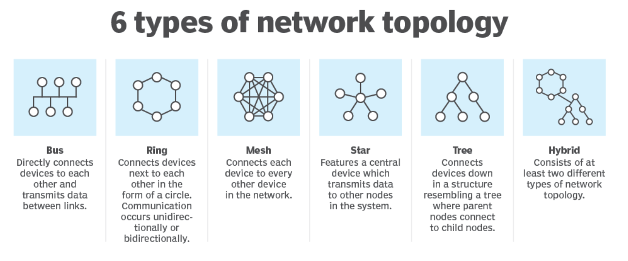
Common Types of Network Topologies

Slide 13
Common Types of Network Topologies
Here's a breakdown of some common network topologies:
Bus Topology: Imagine a single main cable that all devices connect to, like beads on a string. Information travels from one device to another along this shared cable. This is a simple and cost-effective setup, but a malfunction in the main cable can disrupt the entire network.
Star Topology: In this topology, all devices have a dedicated connection to a central hub or switch. This central device acts like a traffic controller, routing data between devices. It's more reliable than a bus topology as a fault in one connection won't affect the entire network. However, the central device becomes a single point of failure.
Ring Topology: Devices are connected in a closed loop, where data travels in one direction around the ring. Each device acts as a repeater, regenerating the signal and passing it on to the next device. This topology can be reliable, but a break in the ring can bring down the entire network.
Mesh Topology: Devices are interconnected with each other, creating multiple paths for data to flow. This provides redundancy and fault tolerance, as data can take alternative routes if one connection fails. Mesh topologies are commonly used in wireless networks.
Tree Topology: This combines characteristics of bus and star topologies. A central hub connects to multiple secondary hubs or switches, which in turn connect to individual devices. This creates a hierarchical structure that is scalable and manageable.
Hybrid network topology Corporate networks often use more than one type of network topology. One topology may be more preferable when compared with another, depending on factors related to performance, reliability and cost. For example, a network professional may configure a wireless LAN that uses a star-based topology for most network connections but also use a wireless mesh network in certain situations, such as when a network cable can't connect to an access point.

Slide 14
Types of Networks:
Networks can also be classified based on their size and purpose. Here are some common network types:
Local Area Network (LAN): A LAN connects devices within a limited geographical area, like a home, office, or school.
Wide Area Network (WAN): A WAN spans a large geographical distance, connecting LANs across cities, countries, or even continents.
Metropolitan Area Network (MAN): A MAN covers a metropolitan area, typically larger than a LAN but smaller than a WAN.
Personal Area Network (PAN): A PAN connects devices within a person's immediate surroundings, like Bluetooth connections between a phone and headset.
Storage Area Network (SAN): A SAN is a dedicated network designed for connecting storage devices to servers.
Choosing the right network topology and type depends on factors like the number of devices, network traffic, and desired level of scalability and reliability.

Slide 15
Open Systems Interconnection
The OSI model was developed by the International Organization for Standardization (ISO) in the late 1970s and early 1980s. It consists of seven layers, each representing a different level of abstraction in the networking process. The layers are:
Physical Layer: This is the lowest layer and deals with the physical transmission of data over the network medium. It includes specifications for cables, connectors, voltages, and physical interfaces.
Data Link Layer: This layer is responsible for establishing and maintaining a reliable link between two devices over a physical connection. It handles issues such as framing, error detection, and flow control.
Network Layer: The network layer deals with routing packets across different networks. It is responsible for logical addressing, routing, and packet forwarding.

Slide 16
Transport Layer: This layer ensures reliable end-to-end communication between two devices. It provides mechanisms for error detection, flow control, and segmentation/reassembly of data.
Session Layer: The session layer establishes, maintains, and terminates connections between applications. It manages sessions and synchronization between devices.
Presentation Layer: This layer is responsible for data translation, encryption, and compression. It ensures that data sent by one application can be understood by another application.
Application Layer: The application layer provides interfaces for applications to access network services. It includes protocols such as HTTP, FTP, SMTP, and DNS.

Slide 17
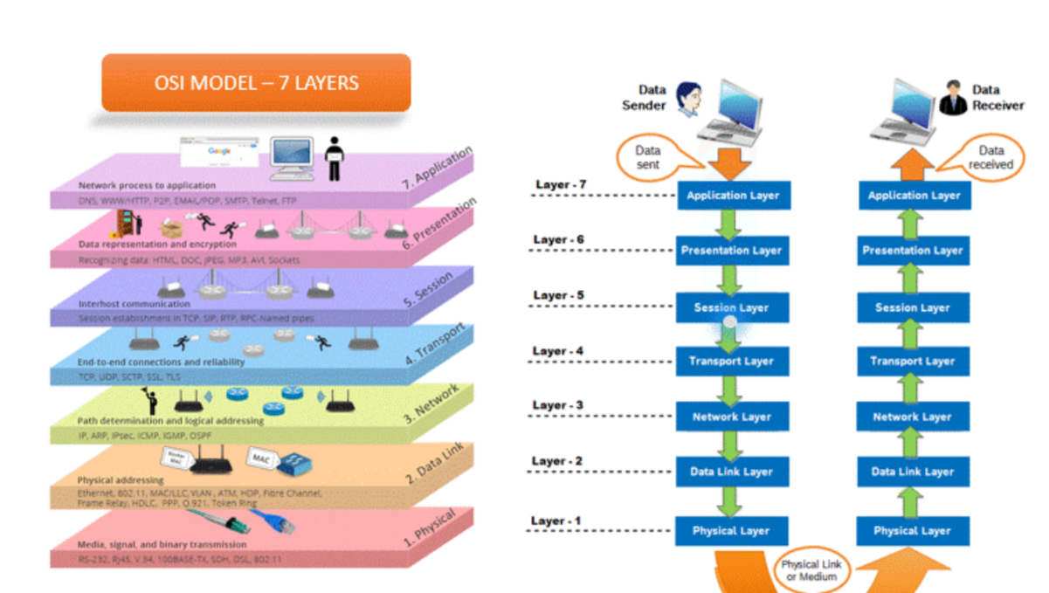

Slide 18
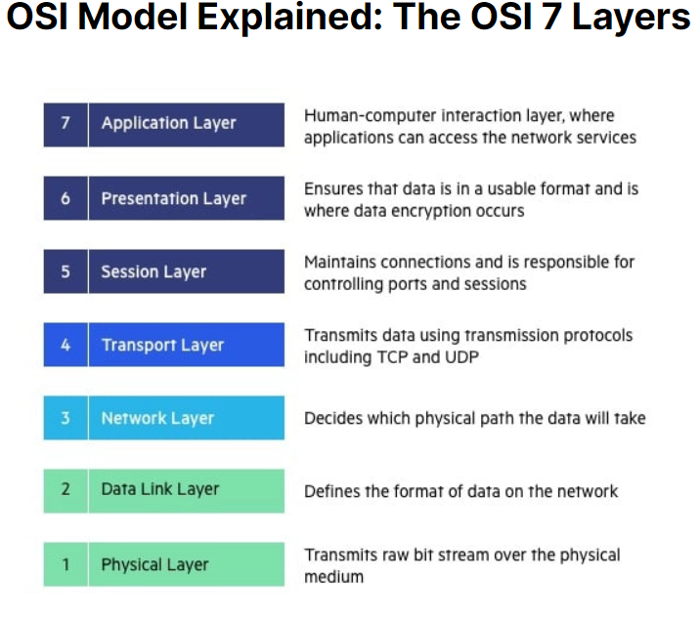

Slide 19
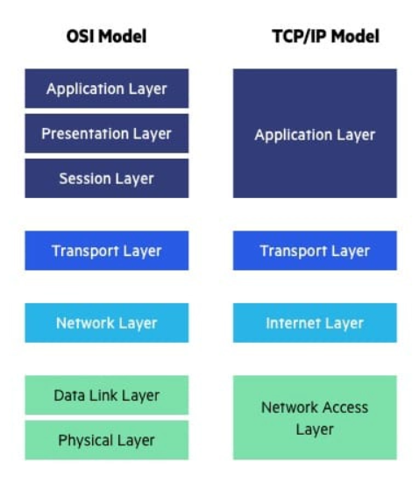

Slide 20
TCP/IP Protocol Suite
The TCP/IP protocol suite is a set of protocols used for communication over the Internet. It was developed in the 1970’s and is based on the principles of the ARPANET, the precursor to the modern Internet. The TCP/IP protocol suite consists of four layers, which loosely correspond to the OSI model:
Network Interface Layer: This layer is similar to the OSI physical and data link layers. It defines protocols for transmitting data over specific types of networks, such as Ethernet or Wi-Fi.
Internet Layer: The Internet layer corresponds to the OSI network layer. It is responsible for addressing, routing, and fragmenting packets across different networks. The Internet Protocol (IP) is the primary protocol used at this layer.
Transport Layer: This layer corresponds to the OSI transport layer. It provides end-to-end communication between applications and handles issues such as reliability, flow control, and error recovery. The Transmission Control Protocol (TCP) and the User Datagram Protocol (UDP) are the two main protocols used at this layer.
Application Layer: The application layer in the TCP/IP model corresponds to the OSI application layer. It includes various protocols and services that applications use to communicate over the network, such as HTTP, FTP, SMTP, and DNS.

Slide 21
Network Devices
Network devices play crucial roles in facilitating communication within and between networks. Here's an overview of some key network devices and concepts:
1. Switch:
A switch operates at the data link layer (Layer 2) of the OSI model.
It connects multiple devices within a local area network (LAN) and selectively forwards data frames based on MAC addresses.
Switches are more efficient than hubs because they create separate collision domains for each port, reducing network congestion and improving performance.

Slide 22
2. Hub:
A hub also operates at the data link layer (Layer 2) of the OSI model.
It connects multiple devices within a LAN and broadcasts incoming data packets to all connected devices.
Unlike switches, hubs do not perform any intelligent packet forwarding; they simply regenerate and broadcast signals to all connected ports.
Hubs are less efficient than switches and can lead to network congestion and collisions, especially in larger networks
3. Router:
A router operates at the network layer (Layer 3) of the OSI model.
It connects multiple networks (e.g., LANs or WANs) and forwards data packets between them based on IP addresses.
Routers use routing tables to determine the best path for forwarding packets, considering factors such as destination IP address, network congestion, and available routes.
Routers provide segmentation, network security (through features like NAT and firewall), and traffic management capabilities

Slide 23
4. Gateway:
A gateway operates at higher layers of the OSI model (usually Layers 3-7).
It serves as an entry and exit point for data entering or leaving a network, translating between different network protocols or formats.
Gateways enable communication between networks with different architectures or protocols, such as connecting a LAN to the Internet.
Circuit Switching:
In circuit switching, a dedicated communication path is established between two devices before data transmission begins.
The path remains allocated for the duration of the communication session, ensuring consistent bandwidth and delay characteristics.
Traditional telephone networks use circuit switching, where a physical circuit is established for the duration of a phone call.

Slide 24
Packet Switching:
In packet switching, data is transmitted in discrete packets that travel independently through the network.
Each packet contains header information (including source and destination addresses) and payload data.
Packets are routed dynamically through the network, allowing for more efficient use of network resources and better scalability.
The Internet is based on packet-switched networks, where data is broken into packets and routed across various interconnected routers to reach its destination.

